Slide 1


Manufacturing Downtime Reduction and Operational Efficiency Improvement
Presented by Data Wizards
Date: 29-3-2025

Slide 2




Executive Summary
Purpose
Key Objectives
Highlights
Analyze and address manufacturing downtime to boost efficiency and minimize disruptions.
Reduce downtime by 20% within 6 months
Key downtime factors include machine failures, operator errors, and inventory shortages.
Decrease operator-induced downtime by 30% within 4 months.
Implement preventive maintenance and optimize inventory management.

Slide 3

Problem Statement
Key Challenges
Impact
Frequent machine adjustments and failures.
Reduced productivity and increased costs.
Operator-induced errors during batch processing and coding
Lower product quality and customer dissatisfaction.
Inventory shortages disrupting production flow.
Reactive maintenance leading to unplanned breakdowns.

Slide 4

Objectives
Develop a continuous monitoring system for sustained efficiency
Implement structured preventive maintenance within 3 months.
Enhance inventory management to reduce related downtime by 25%.
Reduce downtime by 20% and operator-induced errors by 30%.

Slide 5





Implementation Plan
Phase 1
Data collection and validation.
Phase 2
Root cause analysis and analytics.
Phase 3
Corrective measures (training, maintenance).
Phase 4
Monitoring and refinement.

Slide 6








Methodology
Data Collection
Analysis
Cleaning and validation using Excel and SQL.
Exploratory Data Analysis (EDA) using Power BI and Tableau.
Optimization
Root Cause Analysis
Lean Manufacturing and Six Sigma (DMAIC framework).
Fishbone Diagram and Failure Mode Effects Analysis (FMEA).

Slide 7
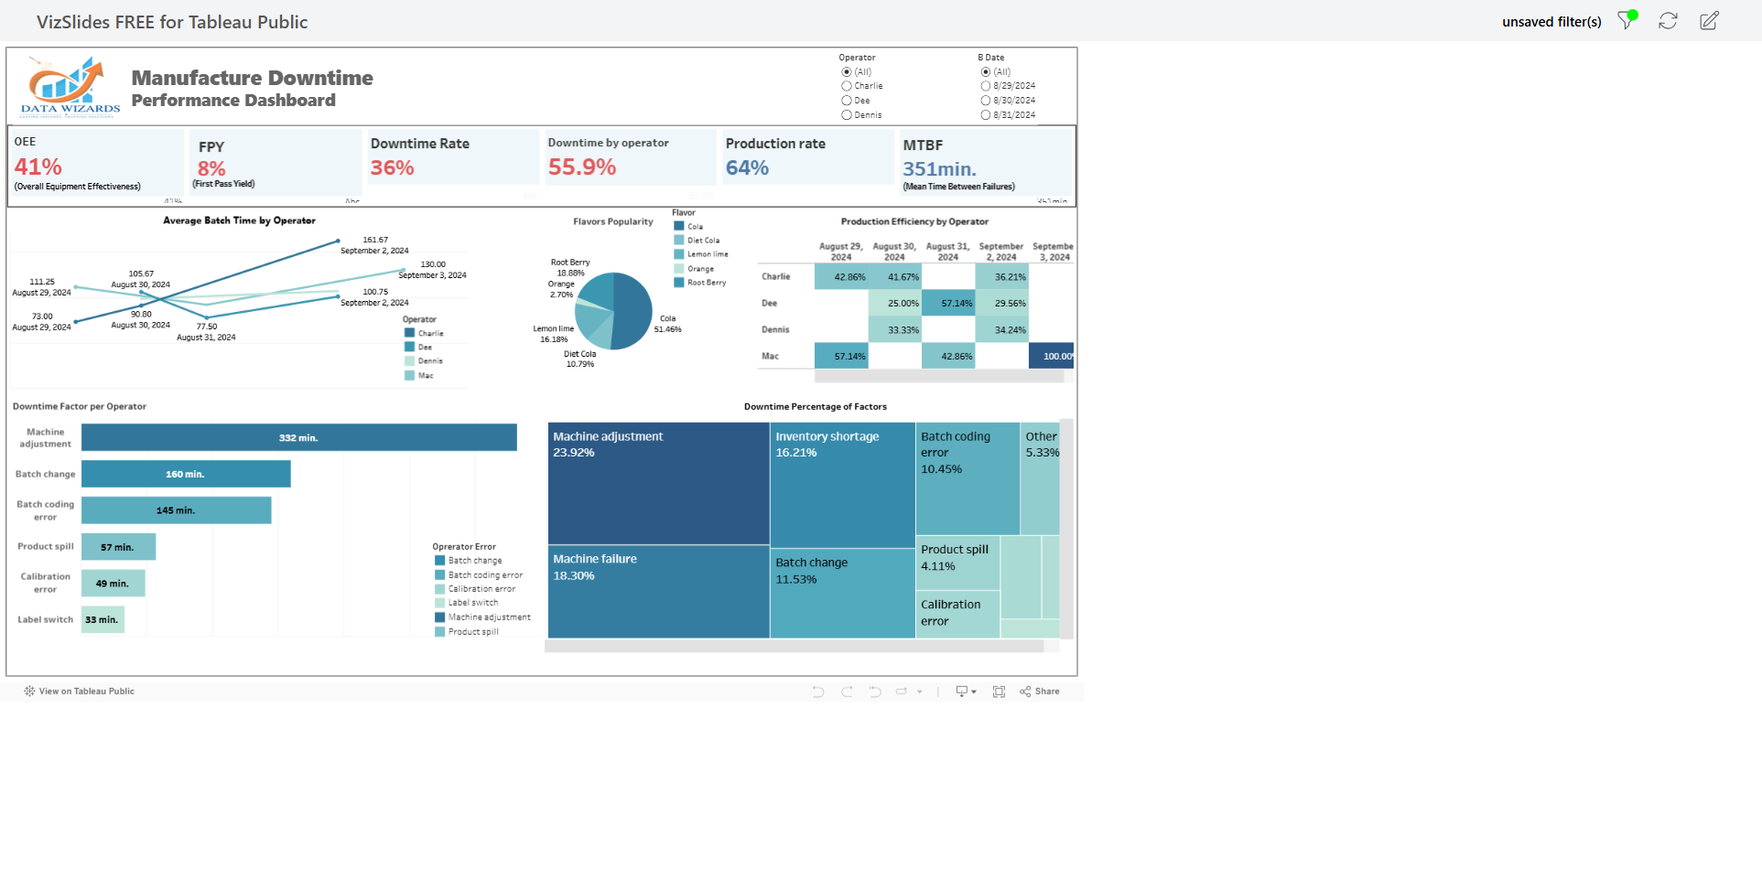
Inter-Active Performance Tableau Dashboard

Slide 8
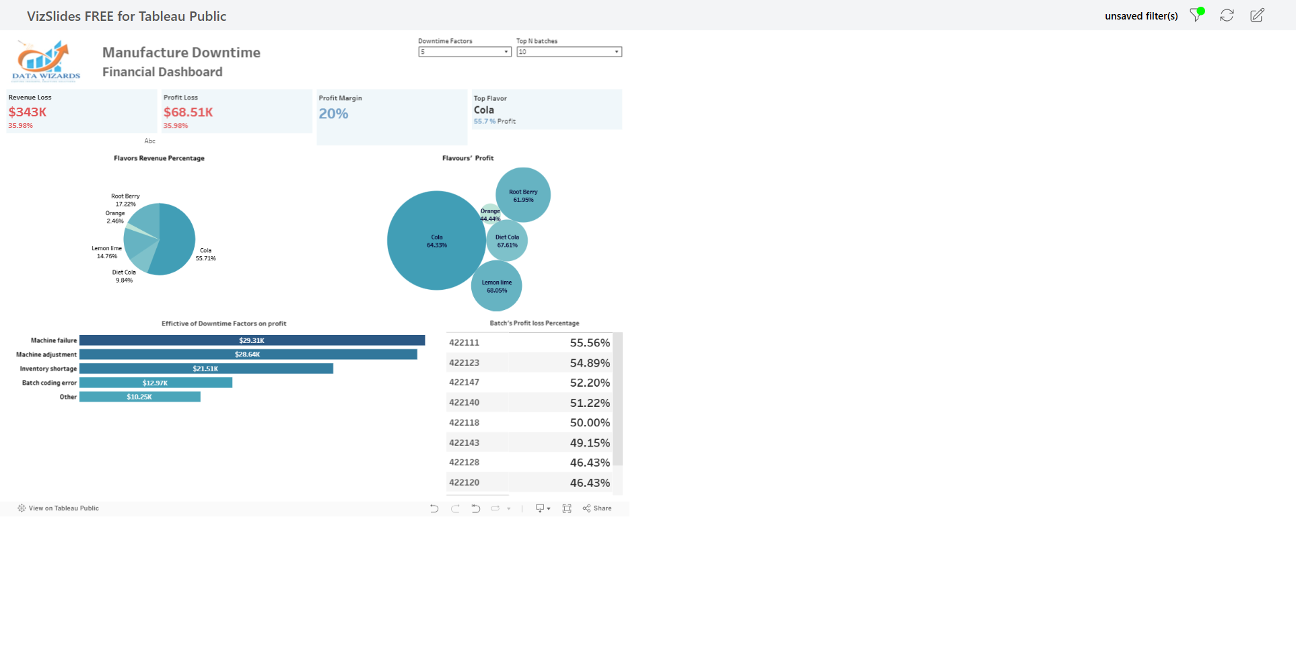
Inter-Active Financial Tableau Dashboard

Slide 9
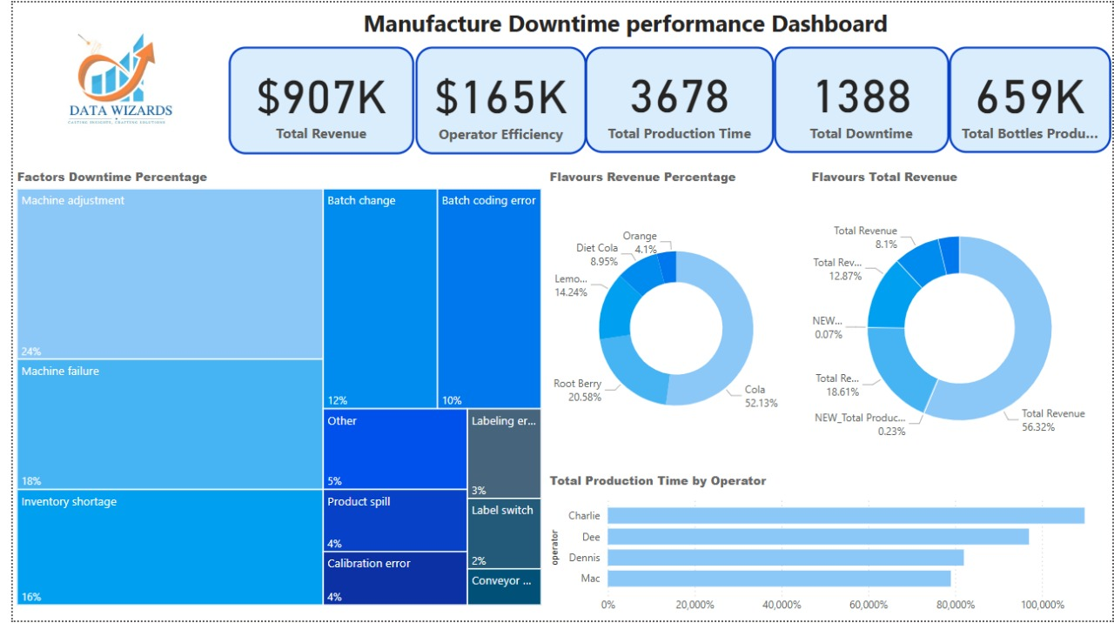
Power Bi Dashboard

Slide 10






Findings
Machine failures and adjustments
Operator errors during batch changes and coding
Inventory shortages causing production delays
Top Downtime Factors as shown above are the primary causes of efficiency loss.
High-Downtime Batches: 422147, 422144, 422146.
Impact
Productivity loss in critical batches.
Operators with frequent errors need additional training.

Slide 11





Recommendations
Establish preventive maintenance schedules
Implement regular maintenance to prevent machine failures
Improve operator training and standardize procedures
Reduce human errors through better training and documentation
Optimize inventory tracking systems
Prevent production delays due to material shortages
Introduce real-time monitoring of downtime metrics
Track performance and identify issues immediately
Explore predictive analytics to prevent failures
Use data to anticipate and prevent problems before they occur

Slide 12
Impact and KPIs
25%
30%
25%
Machine Reliability
Error Reduction
Inventory Improvement
Achieve a 25% reduction in machine-related downtime incidents
Fewer operator-induced errors
Reduction in inventory-related delays
KPIs
Downtime minutes per month.
Operator-related incidents.
Machine reliability metrics.

Slide 13
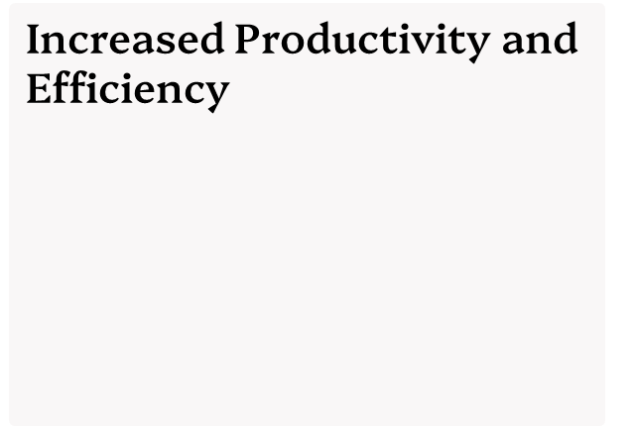
Conclusion
Optimized Inventory
Management
Improved Operator Performance:
maximize production output due to reduced downtime and smoother operations..
through improved tracking and forecasting systems.
Smoother production flow due to better material availability.
through enhanced training and standardized procedures
Next Steps
Continuous Refinement and auditing through verifying control limits
and production efficiency for saving cost and increasing revenue .

Slide 14


Slide 15
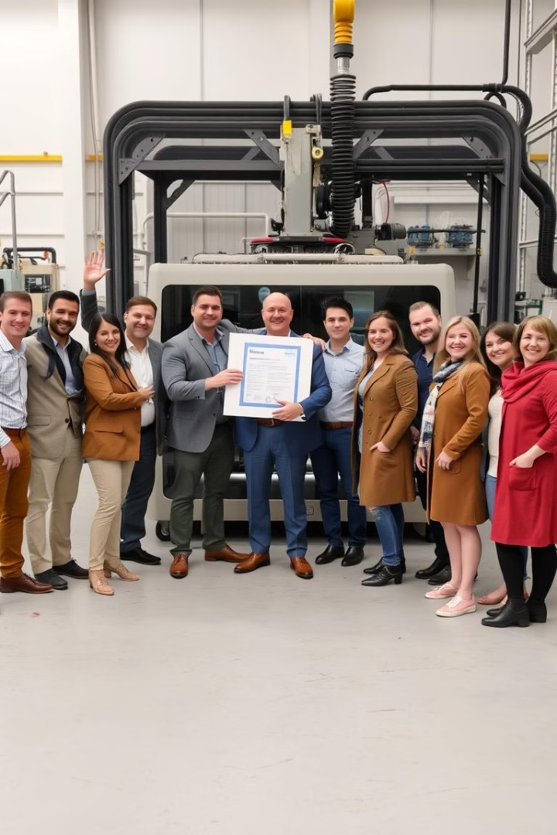
Now, it’s a time for anew start
Thank you

